Slide 1
K I L O W A T T f e s t i v a l
the energy of contemporary scene
multidisciplinary festival founded in 2003 in Sansepolcro

Slide 2
WHERE
Sansepolcro is a small town of 16,000 inhabitants, 330 meters above sea level in the north-east corner of Tuscany, is the last Tuscan municipality before Umbria, bordering the Marche, Romagna is 30 km far.

Slide 3
Piero della Francesca was born in Sansepolcro (around 1410) and he died there on 12nd October 1492.
In the Civic Museum there are 4 works of the Master,
the most famous of which is
the Resurrection

Slide 4
In 2003, a group of three twenty-seven-years old guys was evicted from the theatre of a nearby town and founded in Sansepolcro a company called CapoTrave and a festival called Kilowatt
OUR HISTORY

Slide 5
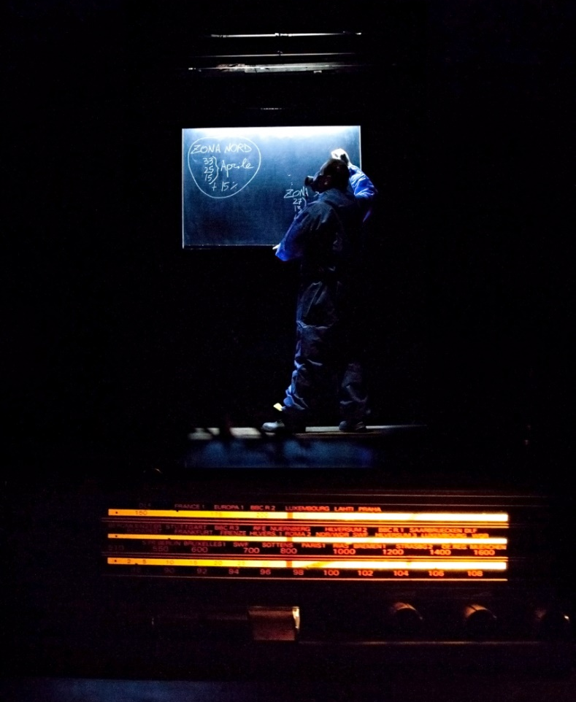
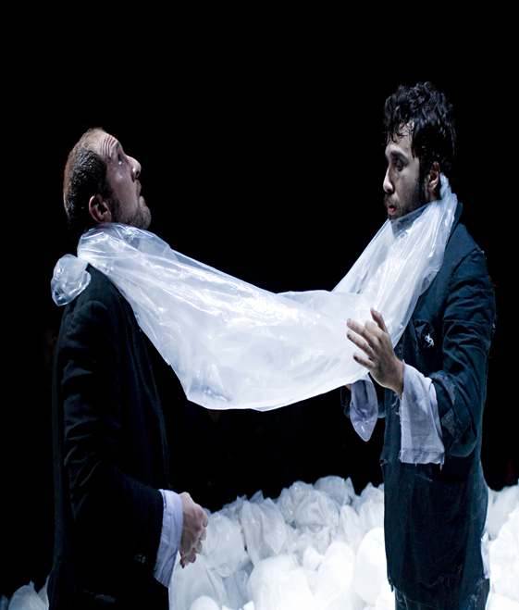
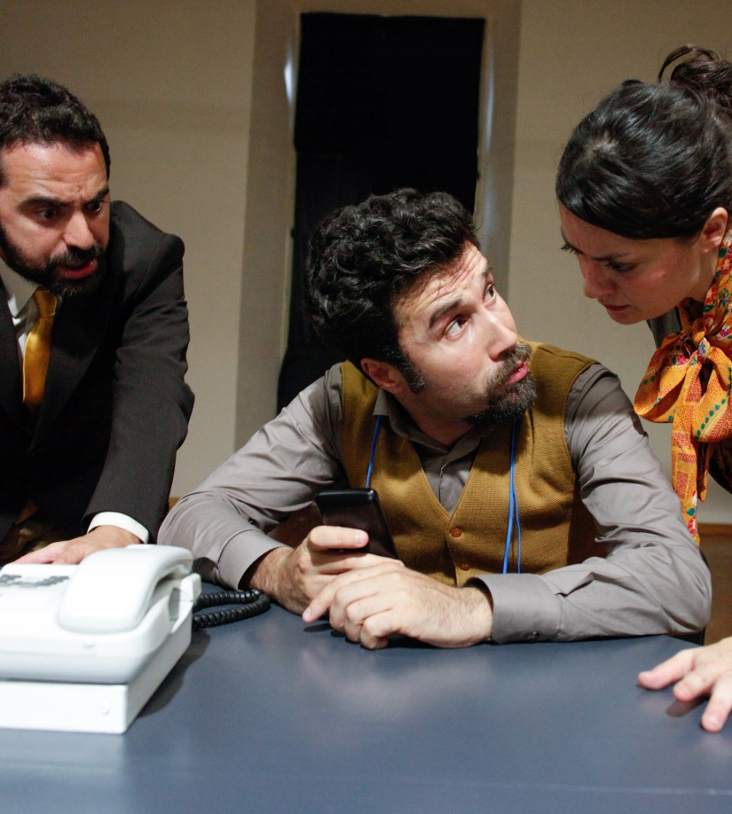
Since then, CapoTrave has produced eleven performances:
Diario intimo (2003), Felicità. Primo studio (2004), La Festa della Regina (2005), I Supermaschi (2007),
Robinsonade (2008),
Virus (2010),
Nel bosco (2012),
Misterman (2012), Piero della Francesca. Il punto e la luce (2015)
Lourdes (2015) La Lotta al Terrore (2017)
www.capotrave.com

Slide 6
4 Kilowatt Festival editions (2003, 2004, 2005, 2006),
very few economies
(less than 10,000 euros per year),
about 500 audience viewers.
In 2006, we developed the project
Visionary selection
we asked the spectators to select themselves a part of the shows to be presented at the festival

Slide 7
the VISIONARI
Citizens of Sansepolcro and the surrounding area
volunteers
not theatre professionals
theater and dance enthusiasts
- 150 citizens of Sansepolcro and its surroundings have been Visionari for at least one year

Slide 8
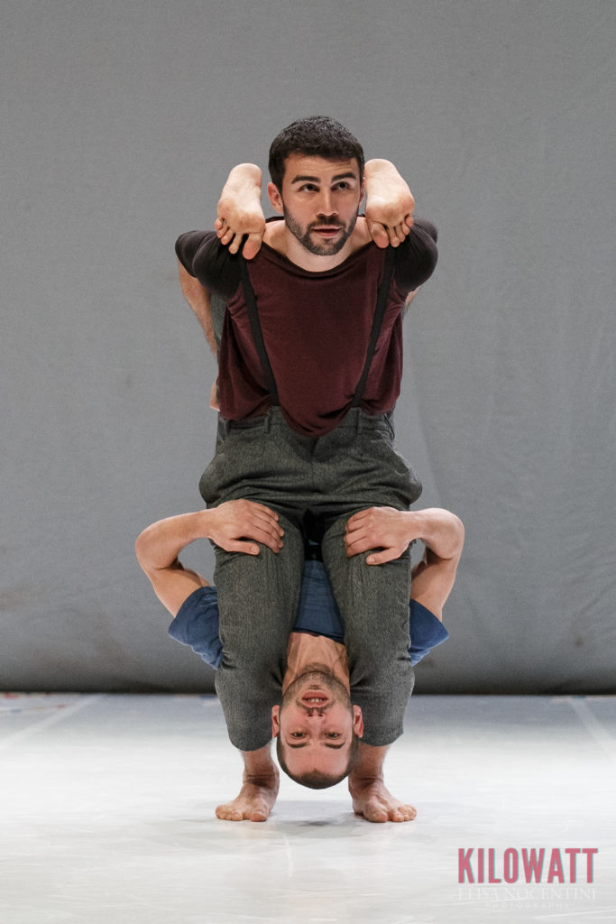
every year…
—> public call for emerging companies
—> about 300 videos arrive
—> the Visionari see them all
—> they choose 9 shows to be invited to the festival
—> for each one they make a Vision/ Evaluation Card
—> all companies receive the Vision/ Evaluation Card
—> At the festival, the 9 invited companies meet the Visionaries in a
public meeting held in the morning after their performance

Slide 9
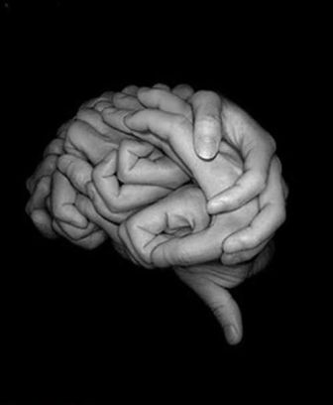
an experiment of collective intelligence
a workshop to sharing participation and democratic engagement.
giving responsibility
in exchange for
sense of belonging

Slide 10
“Ultimately, the stylistic method presupposes the existence of a fourth creator in addition to the author, the director, and the
actor—namely, the spectator. ”
Vsevelod Meyerhold, First Attempts at a Stylized Theatre,
1907
“We don’t need to turn spectators into actors. We do need to acknowledge that every spectator is already an actor in his own story and that every actor is in turn the spectator
of the same kind of story.”
Jacques Rancière, The Emancipated Spectator, 2008

Slide 11
What about the artistic director?
Spectators are not left alone, but they are accompanied and followed by those who defined the project.
The ability to look at artwork from the point of view of the spectators, defines the profile of a professional curator as someone who, without forgetting his/her responsibility as a curator, creates inter-active experiences.

Slide 12
Every year at Kilowatt Festival:
38 dance and theatre shows
12 live concerts
65 performances
4.200 tickets sold
6.000 participants in free events
54 journalists 150 professionals from Europe

Slide 13
Every year the festival supports the production of
about 8 new shows
(Through economic contributions, creative recidencies, distribution support)

Slide 14
5 full-time staff
6 part-time staff 20 seasonal workers for the festival

Slide 15
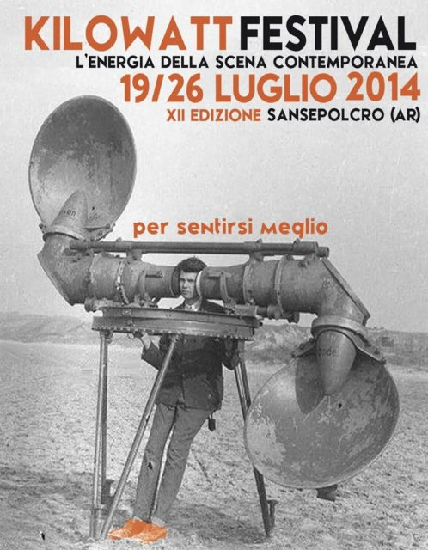
2014
2013

Slide 16
2016
2015

Slide 17
2018
2017

Slide 18
Since 2013, the Regione Toscana finances CapoTrave / Kilowatt as "Residence":
- production
- festival
- managing Teatro alla Misericordia
- about 18 companies a year in creative residence (12-15 days a year)
- Each resident company develops a project of interaction with local target audience

Slide 19
In 2014, the European Commission funded the "Be SpectACTive!" Large-scale co-operation project by CapoTrave / Kilowatt:
12 partners,
9 European countries envolved, 21 productions of new shows 54 creative residencies
108 shows chosen by spectators
1 research project and in-itinere monitoring process.
—> 3,5 million of total budget
In 2018 the project was re-financed for 2018-2022, with 19 partners from 15 countries
What about "active spectatorship"
The context in which the viewer becomes a decision maker in relation to the many aspects of conducting and planning a festival and / or a
theatrical season

Slide 20
Since 2015 “L’Italia dei Visionari”: a national call for eight Visionari groups
Sansepolcro (Kilowatt Festival)
Como (Artificio)
Rimini (Le Città Visibili)
Messina (Teatro Vittorio Emanuele)
Teramo (Circuito Abruzzo Spettacolo)
Milano (Manifatture Teatrali Milanesi)
Livorno (Teatro delle Commedie)
San Felice sul Panaro (MO)

Slide 21
“I ask these different generations: how can we bring Theatre among men?”
–Leo De Berardinis
Introduction to the program of the twenty-fifth “Santarcangelo Dei Teatri” Festival, 1995
“Or the whole town feels that the festival is something of its own, or it’s better to stop it”
–Stefan Schweitzer
a technician of the 3rd edition of Kilowatt Festival, 2005

Slide 22
grazie! / thank you!
www.kilowattfestival.it www.capotrave.com
www.bespectactive.eu

